Slide 1
Resource Cartels
Example: OPEC
Organization of the Petroleum Exporting Countries

Slide 2
Formation of OPEC - 1960
Leading up to 1960, Multinational Oil Companies were slashing their posted prices for Venezuelan and Middle Eastern crude oil
These affected countries formed OPEC to secure the best price available for their oil from the major oil corporations
Goals:
1) get a larger share of the revenues produced by Western oil companies
2) get greater control over production levels

Slide 3
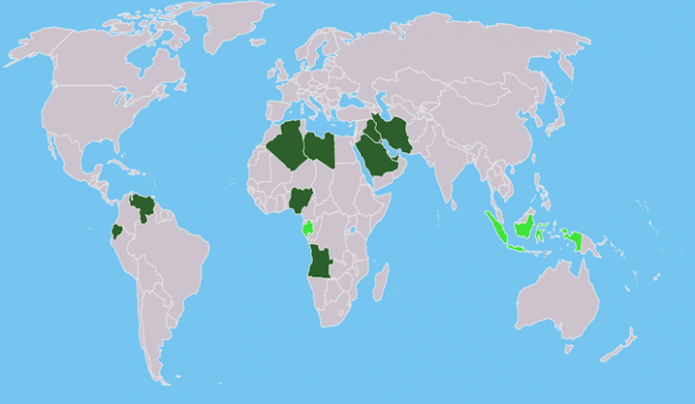
By the early 1970’s, member countries accounted for >50% of worldwide oil production.
Today, OPEC consists of 15 nations, accounting for ~44% of oil production and ~82% of proven reserves

Slide 4
The Yom Kippur War and the 1973 Oil Embargo
Global and OPEC responses to the persistent Arab-Israeli conflict transformed OPEC from a mere cartel into a formidable political force.
Several western countries, including the US supported Israel in the Yom Kippur War
→ OAPEC (subgroup of OPEC of specifically Arab majority nations) enacted significant production cuts and an oil embargo against these Israel-friendly nations

Slide 5
The Shah of Iran speaks..
“The world price of oil is going to rise," the Shah told the New York Times in 1973. You [Western nations] have increased the price of wheat you sell us by 300 percent. You buy our crude oil and sell it back to us, redefined as petrochemicals, at a hundred times the price you've paid to us...; It's only fair that, from now on, you should pay more for oil.

Slide 6
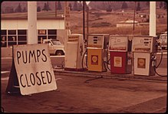
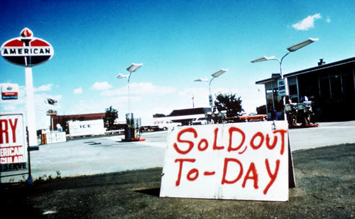
Results?
Embargo lasted 5 months October 17, 1973, and ending on March 18, 1974.
400% Rise in OPEC revenues
Energy rationing and panic
For a time, UK imposed an emergency 3-day workweek
7 European countries banned non-essential Sunday driving
US gas stations closed on Sundays and restricted days gas could be purchased
Global economic recession
Unemployment increased
Inflation surged
Notes:
At the height of the crisis, drivers of vehicles with odd numbered license plates were allowed to purchase gasoline only on odd-numbered days of the month, while drivers with even-numbers were limited to even-numbered days.

Slide 7
Response of western world?
Effect on US and other nations was lasting
International Energy Agency
National emergency stockpiles to withstand future supply disruptions
Oil conservation efforts
Lower speed limits
More energy efficient cars and appliances
Better insulation
Mass transit improvements
Greater emphasis on other energies (coal, natural gas, ethanol, nuclear, alternatives)
Notes:
The IEA has a broad role in promoting alternate energy sources (including renewable energy), rational energy policies, and multinational energy technology co-operation. IEA member countries are required to maintain total oil stock levels equivalent to at least 90 days of the previous year's net imports.
OPEC nations demonstrated convincingly that their oil could be used as both a political and economic weapon against other nations, at least in the short term

Slide 8
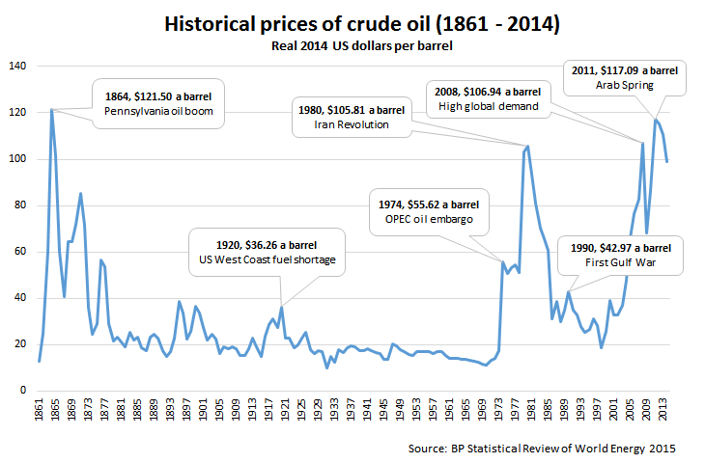

Slide 9
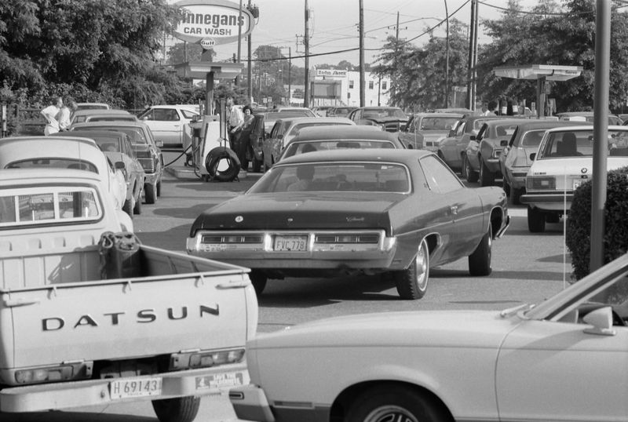
Line at a gas station, June 15, 1979 Price increase during Iran Revolution

Slide 10
Success of OPEC
OPEC has been successful at increasing the price of oil for extended periods
Much of OPEC's success can be attributed to Saudi Arabia's dominance of the world’s oil supply
Saudi Arabia has tolerated cheating on the part of other cartel members
Cut its own production to compensate for other members exceeding production quotas
In 1972, OPEC nations received $23 billion from oil exports, in 1977 they received $140 billion.

Slide 11
Strategic Reserves
Governments stockpile “strategic minerals”
For times of War – when resources could be cut off
The most common strategic reserve is oil.
Also: chromium, cobalt, niobium, nickel, platinum, tantalum, titanium, manganese, aluminum, and others
Notes:
Under the Executive Order, these commodities qualify as “critical minerals” because each has been identified as a non-fuel mineral or mineral material that is essential to the economic and national security of the United States, that has a supply chain vulnerable to disruption, and that serves an essential function in the manufacturing of a product, the absence of which would have significant consequences for the economy or national security.
https://www.usgs.gov/news/interior-releases-2018-s-final-list-35-minerals-deemed-critical-us-national-security-and

Slide 12
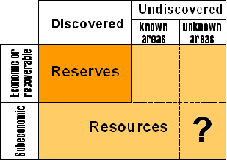
Language check: Resources vs. Reserves
Notes:
Draw on board – x-axis arrow for increasing

Slide 13
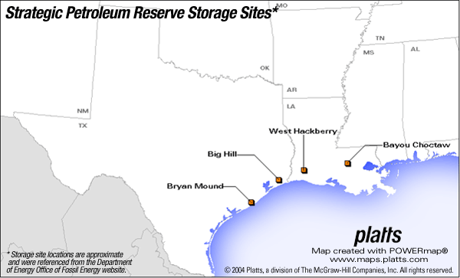
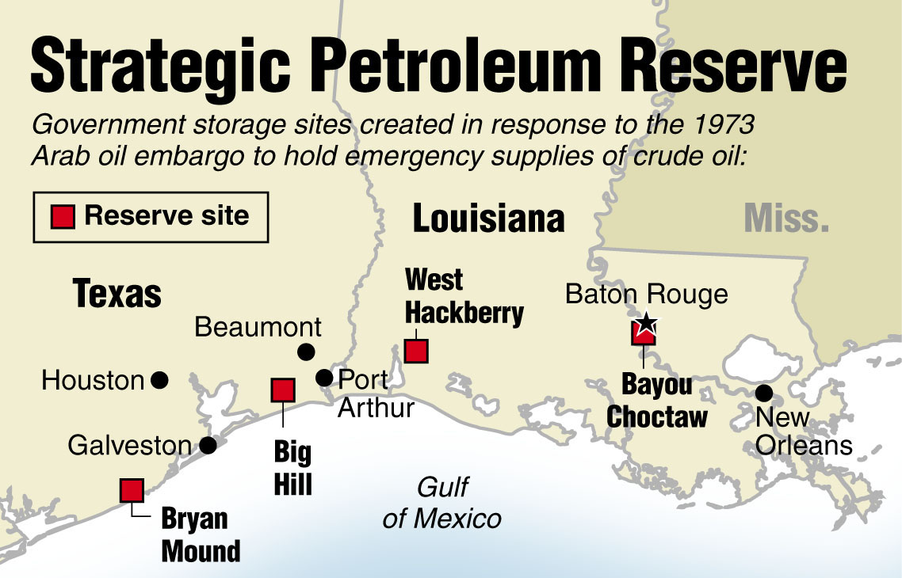
Strategic Petroleum Reserve
Emergency crude oil is stored in the Strategic Petroleum Reserve in salt caverns along the Texas and Louisiana coastline.

Slide 14
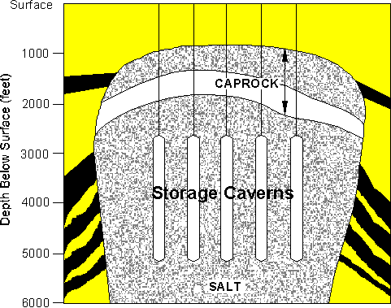
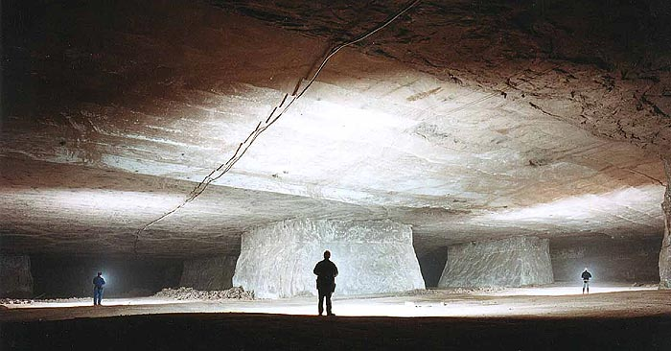
Salt Storage

Slide 15
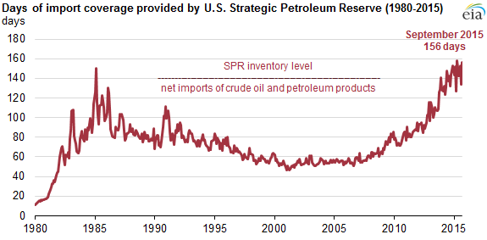
How long would it last if our supplies of oil were cut off?
Amount of oil in the Strategic Reserve

Slide 16
Minerals Strategic Reserves - US Defense Needs
Four minerals are considered particularly essential to U.S. defense and civilian industries:
- chromium
- cobalt
- manganese
- platinum group metals.
Why these 4?
US lacks reserves, must rely on imports from politically volatile regions.

Slide 17
Amount of Strategic Minerals Used in One Jet-Fighter Engine
Mineral | Amount Used (in tons) | Percent Imported
Titanium | 2.7 | 35
Nickel | 2.6 | 73
Chromium | 0.8 | 91
Cobalt | 0.5 | 93
Aluminum | 0.4 | 94
Colombium | 0.1 | 100
Tantalum | 3 pounds | 90
Notes:
Many of these strategic minerals – the ones they choose to stockpile – are needed to keep our military running

Slide 18
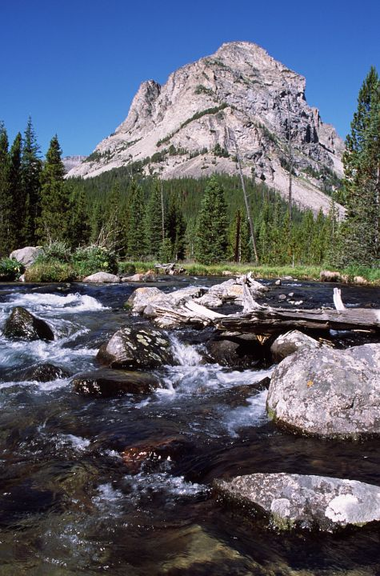

Defense and the Environment
The debate over critical and strategic minerals also brought up the issue of mining on public lands.
E.g. Absaroka-Beartooth Wilderness in Montana
Chromium and platinum-palladium reserves
70% of domestic reserves of platinum group metals.

Slide 19
DeBeers – An example of resource monopoly
The DeBeers company was founded in 1888 to establish control over the diamond market.
Controlled supply - only released enough stones to meet the demand.
The price of diamonds is largely arbitrary
Don’t have the same intrinsic value as other commodities like gold.
Until the start of the 21st century, De Beers effectively had total control over the diamond market as a monopoly. Competition has since dismantled the complete monopoly
Notes:
Today DeBeers sells ~35% of rough diamond production.
The company used several methods. Firstly, it convinced independent producers to join its single channel monopoly. When that did not work, it flooded the market with diamonds similar to those of producers who refused to join in. It purchased and stockpiled diamonds produced by other manufacturers as well as surplus diamonds in order to control prices by limiting supply.^{[41]} Finally, it bought diamonds when prices fell considerably, such as during the Great Depression.^{[42]}

Slide 20


The power of a successful marketing campaign…

Slide 21
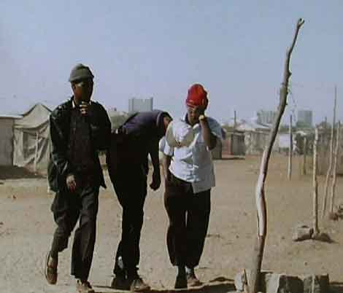
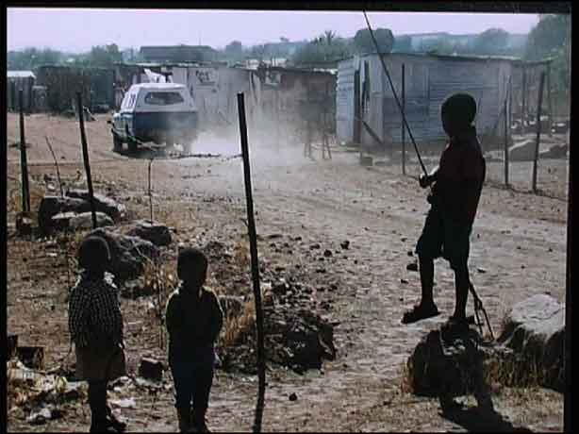
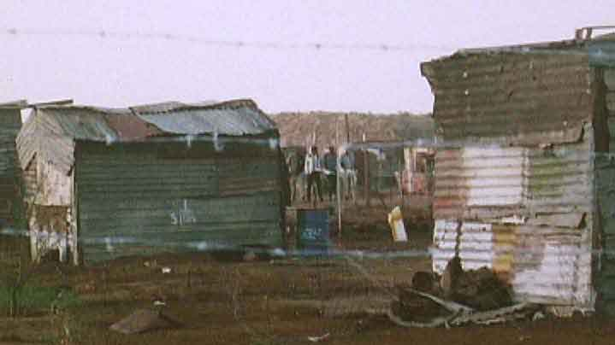
Kept expenses low
Exploitative labor policies
Strict worker control
Migrant workers on limited contracts
Poor working conditions

